Slide 1
Ronald Mangani Department of Economics, Chancellor College, University of Malawi
The Quest for a Pragmatic Economic Management Framework in Malawi
Department of Economics Research Seminar
5 January 2021

Slide 2
Take-aways
Incentive structures shape what peoples become
Get them wrong; you are doomed!
In Malawi (& similar countries) the “success” of neoliberalism is in its “failure”
Its incentive structure is designed to weaken the weak and strengthen the strong
Economic independence is a necessary high-order condition for pragmatic economic management and resilient development
Economic management is too pivotal to be delegated in a very competitive world
Attaining economic independence is challenged by three factors: leadership, status quo, and human resources
But importantly, “development is always and everywhere a leadership-driven process”

Slide 3
Preamble: Our Story is the Story of Africa, yet Unique
Albert Luthuli’s Prophecy …
“Africa is a vital subject matter in the world today, a focal point of world interest and concern. Could it not be that history has delayed her rebirth for a purpose? The situation confronts her with inescapable challenges, but more importantly with opportunities for service to herself and mankind. She evades the challenges and neglects the opportunities to her shame, if not her doom”
Luthuli, 1961

Slide 4
Preamble: Economic Reforms for Resilience?
The 2020 ECAMA Annual Economic Conference Theme
“Going beyond macroeconomic stabilization: the need for building resilience to external shocks”
Economics: scarcity raises value
Experience with the Lenten Pastoral Letters
The 1991 “treason” letter is a treasure; subsequent ones draw little attention
“Reforms” have been debased by SAPs etc
The economic management challenge needs much more than “reforms”
The country needs a “critical juncture”
Say “Economic Restructuring”?
Say “Economic Transformation”?

Slide 5
The Incentive Structure

Slide 6
The Incentive Structure
“The cumulative set of promised rewards and/or punishments that encourage actors to make a set of decisions” (www.boundless.com/economics/)
Behavior of Institutions
What peoples become at local, regional, national or global levels
(e.g. poverty or prosperity, fragility or resilience)
Incentive Structure
Behavior of Individuals
Behavior of countries
Behavior of multi-nationals
Complex interactions, competition, posturing: who gets what, when & how

Slide 7
The Incentive Structure
How does a country incentivize prosperity?
It exacts commensurate reward for good performance, and commensurate punishment for wrong-doing
Facilitates proper risk-return trading (Markowitz, 1952) in all conduct
Get this wrong, and you have all sorts of problems: institutional failures
“an incorrect risk premium is the architect of doom”

Slide 8
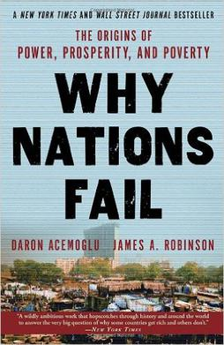
The Incentive Structure
How does a country incentivize prosperity?
Only through a functional state!
“ Secure property rights, the law, public services, and the freedom to contract and exchange all rely on the state, the institution with the coercive capacity to impose order, prevent theft and fraud, and enforce contracts between private parties”
Acemoglu & Robinson, 2012, Why Nations Fail, p. 75

Slide 9
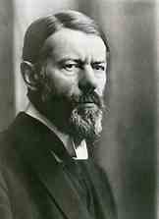
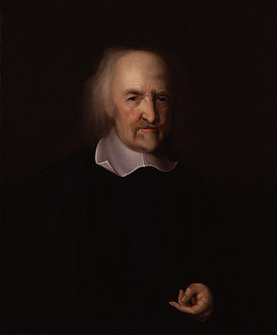
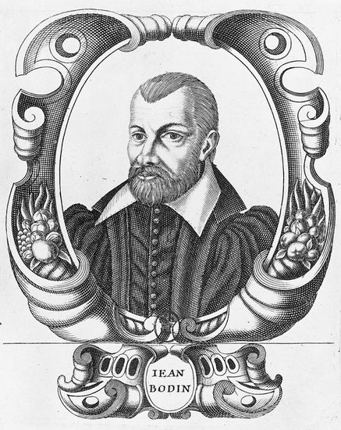
The Incentive Structure
How does a country incentivize prosperity?
Only through a functional state!
If the state does not have or loses the “monopoly of legitimate violence” and the degree of centralization that such a monopoly entails, the state cannot play its role as enforcer of law and order, effective provider of public services and regulator of economic activity
Max Weber, 1919, Politics as a Vocation
Thomas Hobbes, 1651, Leviathan
Jean Bodin, 1576, Les Six livres de la République

Slide 10
The Success of Neoliberalism is in its Failure

Slide 11
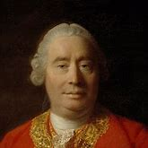
Tragic Neoliberalism
“It is not from the benevolence of the butcher, the brewer, or the baker that we expect our dinner, but from their regard to their own interest”
Adam Smith, 1776, Wealth of Nations

Slide 12
Tragic Neoliberalism
Justification
To address structural economic weaknesses and create resilience to shocks from the economic crisis of the late 1970s!
How?
Through comprehensive policy reforms dangled in return for Western aid since 1981
But what caused the crisis?
Increased cost of sea access due to the Mozambican war – external to the domestic economy
Rise in domestic oil prices due to the 1979 global oil crisis – external to the domestic economy
Decline in world tobacco prices – external to the domestic economy
Episodes of agricultural failure – persistent due to rain-dependence, etc
Mangani, 2020; Chirwa, 2000

Slide 13
Tragic Neoliberalism
The Programmes
Financing
Exogenous Shock Facilities
Extended Credit Facilities
Rapid Credit Facility (2020)
Key issue: unlock western aid ⇔ deepen aid dependence
Period (approx.) | Programme | Objectives
1981 - 1994 | - Structural Adjustment Programmes (SAPs) | Address BoP & fiscal deficit challenges
1995 - 2000 | - Fiscal Restructuring & Deregulation Programmes (FRDPs) - Enhanced SAPs | Address BoP & fiscal deficit challenges
2000 - | - Poverty Reduction Strategy Programmes | Reduce poverty through macro stability

Slide 14
Tragic Neoliberalism
Malawi traded economic sovereignty for Western aid; undertook major reforms, inter alia:
Massive privatization & divestitures: breaking the triad of MDC, ADMARC, Press
“The Government has no role in production. It should only be referee”
Competition will enhance efficiencies
Fiscal restructuring
“The economy is messed up in the treasury and corrected at the central bank”
“Expansionary fiscal policy is inflationary (Woodford, 2001; 1995), contrary to Keynes (1936)
Financial sector reforms
“Financial liberalization will unlock resources for private investment & growth”, McKinnon; Shaw (1973)
“Flexible exchange rate will improve the trade balance & reserves”, Marshall (1923); Lerner (1944)
“Growth is a long-term (not short-term) objective; macro stability should be short-term focus”
Trade opening
“Removing trade barriers will increase welfare, broaden markets, improve the trade balance”
Malawi: an obedient patient that can’t recover
A mixed bag of the good(?), the bad and the ugly!

Slide 15
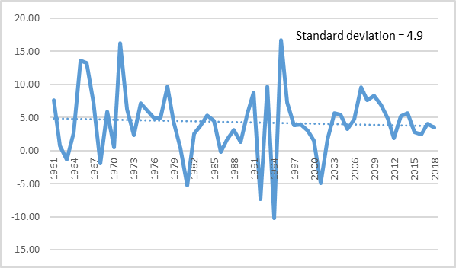
Tragic Neoliberalism
Malawi is getting poorer, by design!
Neoliberalism is anti-growth by design!
Else if it ain’t broken, don’t fix it!
Deployed nuclear weapons to kill mosquitos
Ironically, 6% growth p.a. is what we crave for now!
Over 15 years, it could halve poverty! (NPC, 2020)
 | 1964 - 1980 | 1981 - 2018
GDP growth (average % p.a.) | 6.1 | 3.6
Per capita GDP growth (average % p.a.) | 3.3 | 0.8
Source: WDI
Real GDP Growth (% p.a.)

Slide 16
Tragic Neoliberalism
Malawi is getting poorer, by design!
The World’s Poorest Countries (By GDP/Capita, PPP)
Rank | 2019* | 2015** | 2010***
10 | Chad | Comoros | Afghanistan
9 | Eritrea | Madagascar | CAR
8 | Liberia | Eritrea | Sierra Leone
7 | South Sudan | Mozambique | Eritrea
6 | Mozambique | Malawi | Niger
5 | Niger | Niger | Somalia
4 | Malawi | Liberia | Burundi
3 | D.R. Congo | DRC | Liberia
2 | CAR | Burundi | DRC
1 | Burundi | CAR | Zimbabwe
* https://www.worldatlas.com/articles/the-poorest-countries-in-the-world ** https://data.worldbank.org/indicator/NY.GDP.PCAP.PP.CD ***http://www.financialjesus.com/interesting-economics/top-10-poorest-countries-in-the-world-2010/#

Slide 17
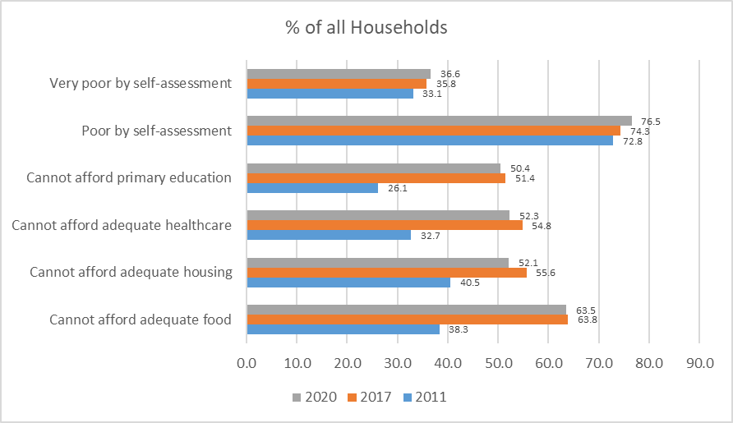
Tragic Neoliberalism
Malawi is getting poorer, by design!
Deteriorating Poverty Between IHS3 (2011) & HIS 5 (2020)

Slide 18
Tragic Neoliberalism
Malawi is getting poorer, by design!
INTERESTING DEBATE:
input subsidies or social cash transfers?
BUT NO DEBATE:
Both = admission that policies are not working for the poor!

Slide 19
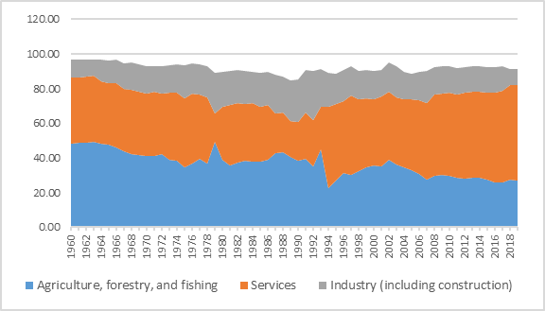
Tragic Neoliberalism
Agriculture and industry are collapsing as we specialize in vending, by design!
Shares of GDP (% p.a.)
Wholesaling and retailing of foreign goods is the key income earner in Malawi (makes up about 16% of GDP), overwhelming the external sector
Trade opening has resulted in:
Dumping
Deepening trade imbalances
Perpetual BoP support (hence aid)
“Unconventional” defense for kwacha
But the exchange rate is main economic destabilizer (Mangani, 2012 & 2016; Ngalawa & Viegi, 2011)

Slide 20
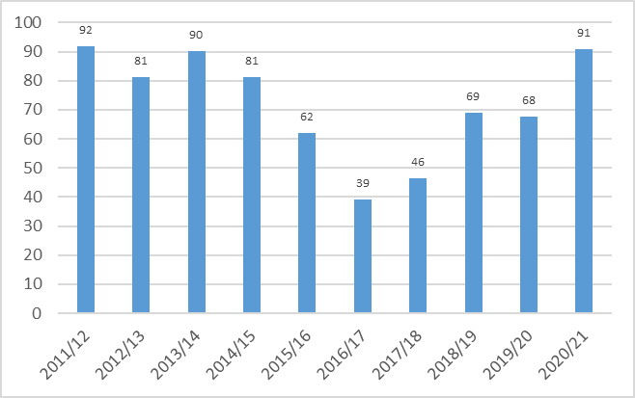
Tragic Neoliberalism
Malawi is an agricultural country that can’t do agriculture, by design!
An agricultural country that prioritizes input subsidisation over agricultural research
FISP expenditure (% of Agriculture ORT)

Slide 21
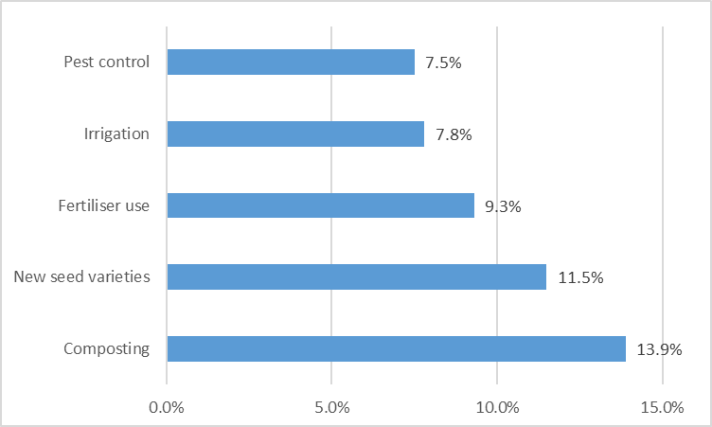
Tragic Neoliberalism
Malawi is an agricultural country that can’t do agriculture, by design!
An agricultural country that hardly tells the farmer how to farm
Farmers accessing extension service (NSO, 2020, IHS5

Slide 22
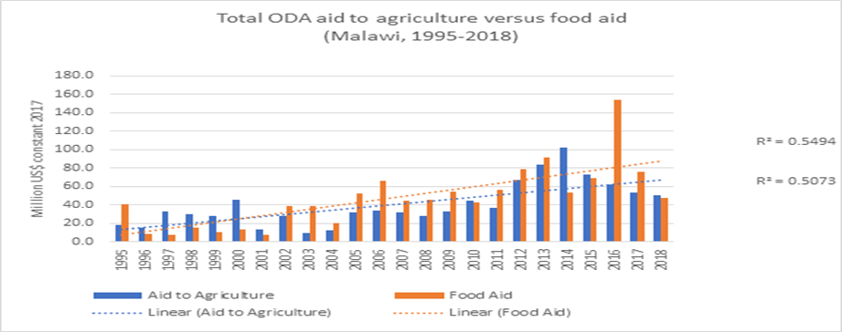
Tragic Neoliberalism
Malawi is an agricultural country that can’t do agriculture, by design!
Malawi Vulnerability Assessment Committee (MVAC) projects that 2.6 million people require humanitarian food assistance
MANA, 27 October 2020
Hence, an agricultural country that can’t feed itself, even with good rains!
“Overall, 62.6 percent of the households reported that they experienced very low food security a week prior to the survey, … and 9.9 percent experienced low food security”.
NSO, 2020, IHS5 p. 191

Slide 23
Tragic Neoliberalism
Aid dependency is deepening, by design!

Slide 24
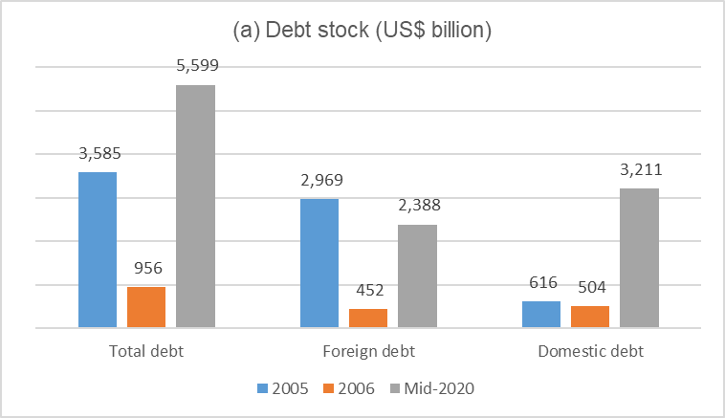
Tragic Neoliberalism
Data sources: World Bank, RBM
The debt burden is depressing … and humiliating, by design!

Slide 25
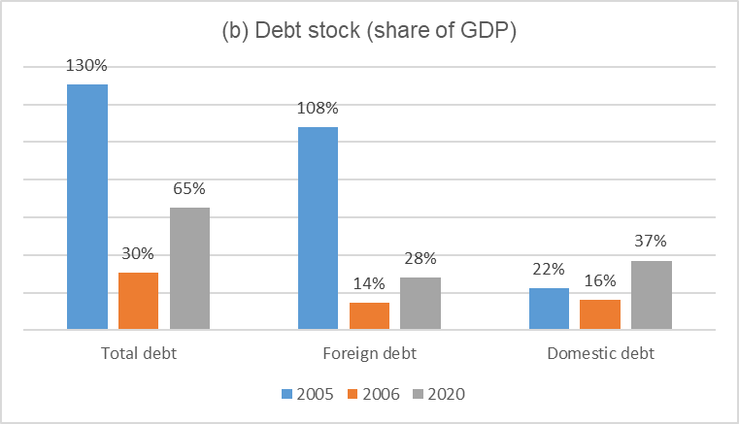
Tragic Neoliberalism
Data sources: World Bank, RBM
The debt burden is depressing … and humiliating, by design!

Slide 26
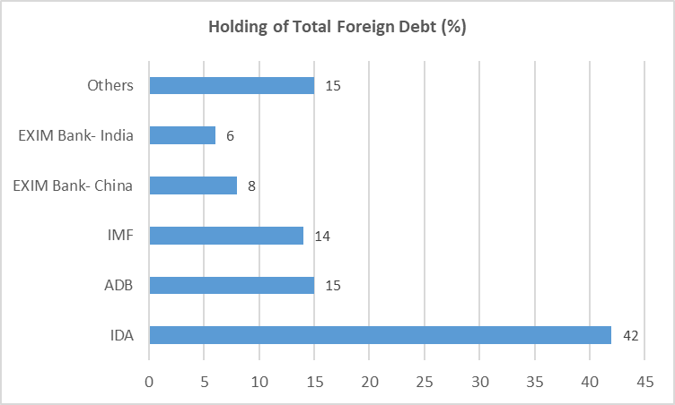
Tragic Neoliberalism
The debt burden is depressing … and humiliating, by design!
World Bank Group holds most foreign debt … yet accuses us of over-borrowing, by design!
Aid leads to more aid, by design: the unpleasant monetarist arithmetic
Sargent & Wallace, 1981; Moyo, 2009,
Debt relief cannot be cause for celebration. Failure to pay is a humiliation, by design!

Slide 27
Tragic Neoliberalism
The fiscal (hence public) sector is not functional, by design!
The are huge and costly public sector wage disparities: neoliberalism has favorites
Raises the marginal utility of corruption
Facilitates conformity with the “rules of the game” by supported SOEs
Erodes human resource & output quality in civil service
Yet there is no evidence of fiscal dominance in Malawi (Mangani, 2020)
Austerity comes with increasing public sector responsibilities
Ever-growing public sector and fiscal pressures
Resources too thinly spread
Punitive effective tax rates, unnaturality & attitude to taxation
From producing to regulating and governance SOE
Overwhelming Treasury recourse
Much easier to extract from regulatory SOEs than from producing SOEs
Declining service quality – education, health, security
Public finance injustice: the heavily taxed middle class no longer accesses most public services

Slide 28
Tragic Neoliberalism
The Financial Sector: the only one profiting … by design!
Emblem of capitalism: most/only lucrative sector
Poverty-deepening intermediation under central bank watch/protection
Financial institutions downplay the distinction between systemic & idiosyncratic risk (Ref: 2012)
Yet McKinnon (1973); Shaw (1973) got it wrong!
Financial liberalization has not increased private lending; created “non-banks”
Data source: RBM, various
Commercial Bank Balance Sheets
 | June 2020 | June 2018 | 1990
Assets/Liabilities (% of GDP) | 30.4 | 29.4 | 20.5 | ok
Private sector deposits (% of GDP) | 13.9 | 17.5 | 12.9 | not ok
Private sector loans (% of GDP) | 8.4 | 8.3 | 10.1 | not ok
Private sector loans (% of assets) | 27.8 | 28.3 | 49.0 | too bad
Official sector loans (% of assets) | 37.5 | 19.5 | 12.0 | crowding-out?

Slide 29
Tragic Neoliberalism
Criticism against deficit-budgeting by orthodox economists is dangerous and damaging
Capital account deficit is a necessary stimulant with idle resources (Keynes, 1936; Lerner, 1943)
Poses a worrisome limitation on the government’s ability to pursue public purpose (Armstrong, 2019)
Resurgence of interest in Keynes’ work among policy-makers since the financial crisis, 2007-08
Should have catalysed an end to the neoclassical domination, but for power play; incentive structure (Skidelsy, 2010; Dymski, 2013)
COVID-19 creates new wave of interest in the economic role of the state
Active fiscal policy pivotal in resolving the crisis (Obeng-Odoom, 2020)

Slide 30
Tragic Neoliberalism
There is no scientific evidence of fiscal dominance in Malawi
“… fiscal deficits and domestic financing are generally not inflationary in Malawi, contrary to the established neoliberal theory” Mangani, 2020)
We can avoid excessive aversion to public debt to borrow for investment (not consumption)
There is nothing characteristically bad about government borrowing; macroeconomic policies must reflect pragmatism rather than consistency with some traditional doctrine; and that excessive aversion to public debt may lead to bad policies Armstrong, 2019
We all know the primary objective of neoliberalism
Neoliberalism was designed to serve the economic and geopolitical interests of Western governments Chipeta, 2009
Neoliberalism has not delivered Pareto-optimal outcomes in Malawi
“Liberalisation of the economy is the institutionalization of greed” Asaria, 1994

Slide 31
Tragic Neoliberalism
How is Such Economic Immorality Sustained?
Brainwashing: mental programming & enslavement
Divide & rule: differential public sector incentives
(e.g. central bank independence)
Distractions from things that matter most
(e.g. from the mismatch between population & economic growth to homosexuality
Sheer collective gullibility
“They may indeed see but not perceive, and may indeed hear but not understand, lest they should turn and be forgiven (i.e., and prosper)” The Bible, Mark 4:12

Slide 32
The Necessity for Economic Independence

Slide 33
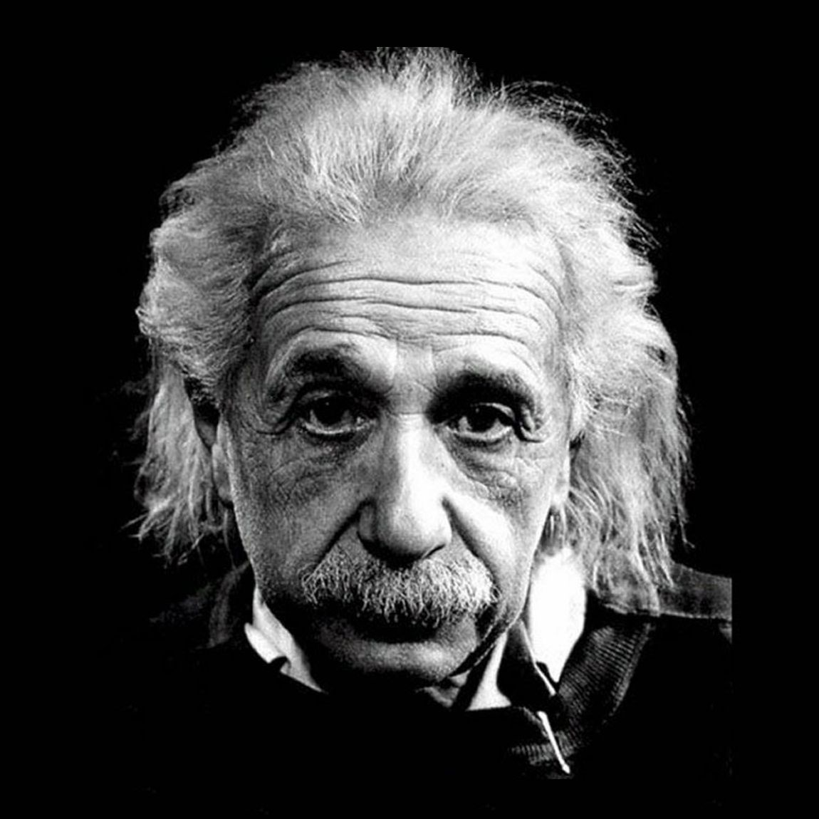
The Necessity of Economic Independence
“Insanity: doing the same thing over and over again and expecting different results.” Albert Einstein
“If you always do what you always did, you’ll always get what you always got” Unknown
The neoliberal experiment has been running for too long
Stuck in the short-run for 40 years!
It makes mockery of political independence
It will not halt itself; it is “delivering”!
“Mfundo zachumazi zabwera udyo” (Mlaka Maliro)

Slide 34
The Necessity of Economic Independence
Economic independence is much easier said than done; high order; suicidal
Lumumba, Sankara, Gadaffi’s, Mugabe
Will require very concerted effort and focus
Malawi needs disentanglement from the shackles of economic dependence
Malawi needs pragmatic economic management
Malawi must develop home-grown solutions (Ref: Singapore, Tanzania, etc)
Malawi needs a developmental state: don’t throw away Keynes & Lerner
Malawi must rationalize aid (and financing in general) to work for country
Actualize presidential hints on economic independence; aid graduation
“I am fully aware that while our founding fathers and mothers accomplished their goal of national liberation and their sons and daughters accomplished their goal of political liberation, it is your generation that must accomplish the goal of economic liberation” L. Chakwera, 6 July 2020
“Economic management is too pivotal to delegate”

Slide 35
Economic Independence:
The Enormous Challenge of Attainment

Slide 36
Challenge to Economic Independence #1: Leadership
“Development is always and everywhere a leadership-driven process”
Malawi has been running costly, non-converging experiments with leadership
We have tried the old and not-so-old; male and female; prepared and accidental, diasporic and home-grown; fine minds and dunderheads, educated and educationally deprived; outright thieves and …
Have we paid in full for the August 1964 Cabinet Crisis?
Malawi has a rare opportunity to reset the leadership button
Changing political leadership creates an opportunity for implementing comprehensive economic policy reforms to achieve development outcomes Williamson, 1994
Did we really have a government in waiting post-February 2020?
Is it another “stab in the dark”?
Is it “the more things change, the more they remain the same”?

Slide 37
Challenge to Economic Independence #1: Leadership
“Development is always and everywhere a leadership-driven process”
Leadership = the political will to drive change, not joining the masses in lamentation
No common problems ⇔ no need for leadership
“Bad law = law that thwarts good leadership from doing the right thing”
Dilemma: democracy versus political stability; patriotism, benevolence
(Africa’s) model economies are not necessarily model democracies
“There is no debate that visionary and transformational leadership characterized by positive values such as unity, patriotism, selflessness, integrity and responsibility is central to the ongoing transformation in Rwanda”
https://www.newtimes.co.rw

Slide 38
Challenge to Economic Independence #1: Leadership
“Development is always and everywhere a leadership-driven process”
“.. the remedy for Malawi’s endemic poverty and development stagnation lies in the emergence of a leadership that will be inspired by a sense of honour, duty and country…. a larger-than-life leadership that could preside over the creation of inclusive economic and political institutions, and adamantly promote their functionality as a foundation for durable macroeconomic and social … driven and owned by the country’s citizens themselves, rather than one moulded by self-aggrandising external influences. It is only through the emergence of such a leadership and institutions that the shackles of neo-colonialism will be broken; that independence will cease to be a sham; and that a worrisome trend towards the prophesised (by Luthuli) doom of a failed state will be reversed.”
Mangani, 2020

Slide 39
Challenge to Economic Independence #2: Proponents
“Change is always resisted by those who profit from status quo”
The vested interests are grave, the opportunity costs are high
Recall: incentive structures
Is graduation from neoliberalism even feasible/conceivable?
Will its proponents & vested interests leg go?
If so, how should this be done?
Shock-treatment vs planned transition?

Slide 40
Challenge to Economic Independence #3: Human Resource
“How do we deal with deep Indoctrination, brainwashing & sheer gullibility?”
The struggle for economic independence is a different ball-game
Fought more intellectually than with guns and bombs, save for the fate of early martyrs
So much education; very little learning
Dogmatic, inflexible academics got us here
We should burry our heads in the sand; apologize
“Emancipate yourself from mental slavery” – Robert Nest Marley
There will be need to develop a critical mass of though leaders to hatch local solutions
And a critical mass of thought followers to interpret and implement them!
Debased education system offers little hope

Slide 41
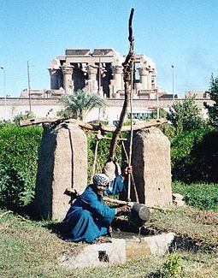
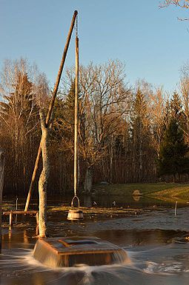
Finally, as we usually pray for good rains …
Submission: A Better Prayer
Don’t pray for rain as if the “shadoof” is yet to be invented;
Pray for the intelligence/wisdom to “see and perceive”; to “hear and understand”
“God Does Not Change The Condition Of A People Unless They Change It Themselves”
Qur’an 13:11

Slide 42
TX
zikomo

